Slide 1
Create components with Power Apps Component Framework

Slide 2
What is Microsoft Dataverse?
Note
Effective November 2020:
Common Data Service has been renamed to Microsoft Dataverse. Learn more
Some terminology in Microsoft Dataverse has been updated. For example, entity is now table and field is now column. Learn more

Slide 3
Agenda
Get started with Power Apps component framework
Build a Power Apps component
Use advanced features with Power Apps component framework
Notes:
This module is a demo/exercise heavy and has very little theory in Lesson 2 & 3

Slide 4

Get started with Power Apps component framework
Notes:
This module is a demo/exercise heavy and has very little theory in Lesson 2 & 3

Slide 5
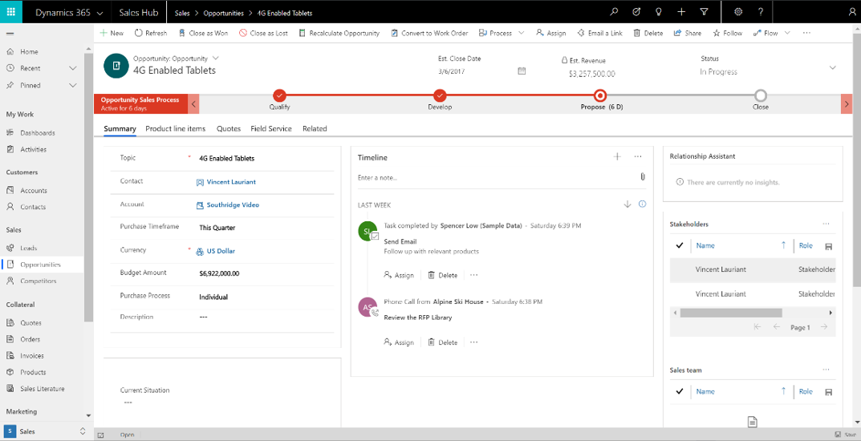
Introduction to Power Apps component framework
Microsoft Power Apps component framework helps you create reusable components that can be used within your Power Apps applications.
Notes:
This module is a demo/exercise heavy and has very little theory in Lesson 2 & 3
Microsoft Power Apps component framework helps you create reusable components that can be used within your Power Apps applications. The component framework empowers developers and app makers to build code components when the out-of-the-box components don't fit an app maker's needs. Before the Power Apps component framework existed, people had to rely on HTML web resources to provide any form of custom presentation to a Power Apps' form. Now, you can use a more modernized framework that allows an abundance of capabilities to be exposed to your app that would otherwise be impossible to access or, even worse, be unsupported by Microsoft.
For example, the existing screen might render similar to the following image.
However, if you reconfigured your app to use custom Power Apps components, your app might look something like the following image.
Microsoft has significant investment in ensuring that Power Apps components are built on top of a robust framework that supports modern web practices. A few of the advantages that you are afforded as a result are:
Access to a rich set of framework APIs that expose capabilities like component lifecycle management, contextual data, and metadata
Support of client frameworks such as React and AngularJS
Seamless server access through Web API, utility and data formatting methods, device features like camera, location, and microphone, in addition to easy-to-invoke UX elements like dialogs, lookups, and full-page rendering
Optimization for performance
Reusability
Use of responsive web design principles to provide an optimal viewing and interaction experience for any screen size, device, or orientation
Ability to bundle all files into a single solution file
It might be said that if you can build it in HTML+JavaScript, you can build it as a Power Apps component. However, common types of components that you might want to use in a Power Apps application might be:
A custom control for a field on a form
A custom grid (or subgrid) to display data in a tabular format
A component that displays content from external services
The Power Apps community has been active in building out components that they have deemed valuable to share with others. For example, a common requirement is to validate user input against a regular expression. While you could write Client Script to perform this validation, or even use your own Power Apps component, it might be beneficial for you to rely on the community to determine if someone else has already solved this problem for you.
Numerous samples as such can be found at PCF Gallery. If you're interested in experimenting with pre-built Power Apps components in your solution, this documentation is a great place to start.
At the time of this writing, Power Apps component framework is still a relatively new technology. While it is robust and well-tested, you might encounter areas where you'll need assistance. The best place to go for assistance is the Power Apps component framework, ALM & Pro Dev community forum, where you can find a wealth of questions and answers to a wide variety of topics, and where you can submit your own questions as well.

Slide 6
Introduction to Power Apps component framework
Microsoft Power Apps component framework helps you create reusable components that can be used within your Power Apps applications.
Notes:
Microsoft Power Apps component framework helps you create reusable components that can be used within your Power Apps applications. The component framework empowers developers and app makers to build code components when the out-of-the-box components don't fit an app maker's needs. Before the Power Apps component framework existed, people had to rely on HTML web resources to provide any form of custom presentation to a Power Apps' form. Now, you can use a more modernized framework that allows an abundance of capabilities to be exposed to your app that would otherwise be impossible to access or, even worse, be unsupported by Microsoft.
For example, the existing screen might render similar to the following image.
However, if you reconfigured your app to use custom Power Apps components, your app might look something like the following image.
Microsoft has significant investment in ensuring that Power Apps components are built on top of a robust framework that supports modern web practices. A few of the advantages that you are afforded as a result are:
Access to a rich set of framework APIs that expose capabilities like component lifecycle management, contextual data, and metadata
Support of client frameworks such as React and AngularJS
Seamless server access through Web API, utility and data formatting methods, device features like camera, location, and microphone, in addition to easy-to-invoke UX elements like dialogs, lookups, and full-page rendering
Optimization for performance
Reusability
Use of responsive web design principles to provide an optimal viewing and interaction experience for any screen size, device, or orientation
Ability to bundle all files into a single solution file
It might be said that if you can build it in HTML+JavaScript, you can build it as a Power Apps component. However, common types of components that you might want to use in a Power Apps application might be:
A custom control for a field on a form
A custom grid (or subgrid) to display data in a tabular format
A component that displays content from external services
The Power Apps community has been active in building out components that they have deemed valuable to share with others. For example, a common requirement is to validate user input against a regular expression. While you could write Client Script to perform this validation, or even use your own Power Apps component, it might be beneficial for you to rely on the community to determine if someone else has already solved this problem for you.
Numerous samples as such can be found at PCF Gallery. If you're interested in experimenting with pre-built Power Apps components in your solution, this documentation is a great place to start.
At the time of this writing, Power Apps component framework is still a relatively new technology. While it is robust and well-tested, you might encounter areas where you'll need assistance. The best place to go for assistance is the Power Apps component framework, ALM & Pro Dev community forum, where you can find a wealth of questions and answers to a wide variety of topics, and where you can submit your own questions as well.

Slide 7
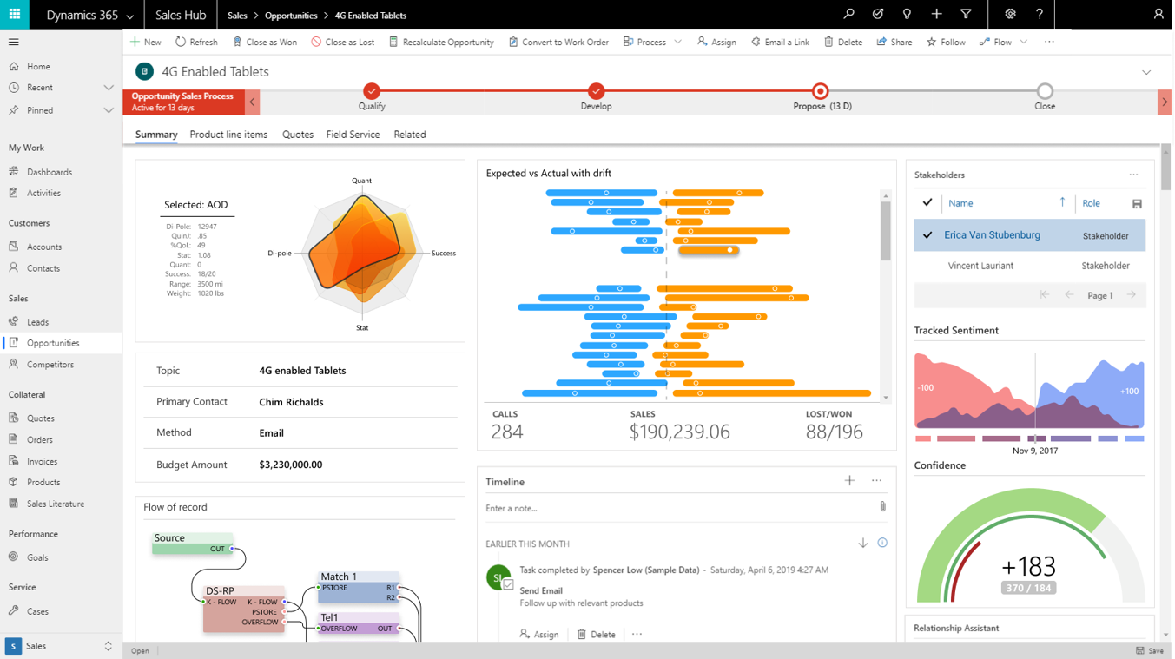
Introduction to Power Apps component framework
However, if you reconfigured your app to use custom Power Apps components, your app might look something like the following image.
Notes:
Microsoft Power Apps component framework helps you create reusable components that can be used within your Power Apps applications. The component framework empowers developers and app makers to build code components when the out-of-the-box components don't fit an app maker's needs. Before the Power Apps component framework existed, people had to rely on HTML web resources to provide any form of custom presentation to a Power Apps' form. Now, you can use a more modernized framework that allows an abundance of capabilities to be exposed to your app that would otherwise be impossible to access or, even worse, be unsupported by Microsoft.
For example, the existing screen might render similar to the following image.
However, if you reconfigured your app to use custom Power Apps components, your app might look something like the following image.
Microsoft has significant investment in ensuring that Power Apps components are built on top of a robust framework that supports modern web practices. A few of the advantages that you are afforded as a result are:
Access to a rich set of framework APIs that expose capabilities like component lifecycle management, contextual data, and metadata
Support of client frameworks such as React and AngularJS
Seamless server access through Web API, utility and data formatting methods, device features like camera, location, and microphone, in addition to easy-to-invoke UX elements like dialogs, lookups, and full-page rendering
Optimization for performance
Reusability
Use of responsive web design principles to provide an optimal viewing and interaction experience for any screen size, device, or orientation
Ability to bundle all files into a single solution file
It might be said that if you can build it in HTML+JavaScript, you can build it as a Power Apps component. However, common types of components that you might want to use in a Power Apps application might be:
A custom control for a field on a form
A custom grid (or subgrid) to display data in a tabular format
A component that displays content from external services
The Power Apps community has been active in building out components that they have deemed valuable to share with others. For example, a common requirement is to validate user input against a regular expression. While you could write Client Script to perform this validation, or even use your own Power Apps component, it might be beneficial for you to rely on the community to determine if someone else has already solved this problem for you.
Numerous samples as such can be found at PCF Gallery. If you're interested in experimenting with pre-built Power Apps components in your solution, this documentation is a great place to start.
At the time of this writing, Power Apps component framework is still a relatively new technology. While it is robust and well-tested, you might encounter areas where you'll need assistance. The best place to go for assistance is the Power Apps component framework, ALM & Pro Dev community forum, where you can find a wealth of questions and answers to a wide variety of topics, and where you can submit your own questions as well.

Slide 8
Power Apps component framework advantages
A few of the advantages that you are afforded as a result are:
Access to a rich set of framework APIs that expose capabilities like component lifecycle management, contextual data, and metadata
Support of client frameworks such as React and AngularJS
Seamless server access through Web API, utility and data formatting methods, device features like camera, location, and microphone, in addition to easy-to-invoke UX elements like dialogs, lookups, and full-page rendering
Optimization for performance
Reusability
Use of responsive web design principles to provide an optimal viewing and interaction experience for any screen size, device, or orientation
Ability to bundle all files into a single solution file
Notes:
Microsoft has significant investment in ensuring that Power Apps components are built on top of a robust framework that supports modern web practices. A few of the advantages that you are afforded as a result are:
Access to a rich set of framework APIs that expose capabilities like component lifecycle management, contextual data, and metadata
Support of client frameworks such as React and AngularJS
Seamless server access through Web API, utility and data formatting methods, device features like camera, location, and microphone, in addition to easy-to-invoke UX elements like dialogs, lookups, and full-page rendering
Optimization for performance
Reusability
Use of responsive web design principles to provide an optimal viewing and interaction experience for any screen size, device, or orientation
Ability to bundle all files into a single solution file

Slide 9
Types of components that you can add
A custom control for a field on a form
A custom grid (or subgrid) to display data in a tabular format
A component that displays content from external services
Notes:
It might be said that if you can build it in HTML+JavaScript, you can build it as a Power Apps component. However, common types of components that you might want to use in a Power Apps application might be:
A custom control for a field on a form
A custom grid (or subgrid) to display data in a tabular format
A component that displays content from external services

Slide 10
Types of components that you can add
Community components
Where to find help
Notes:
Community components
The Power Apps community has been active in building out components that they have deemed valuable to share with others. For example, a common requirement is to validate user input against a regular expression. While you could write Client Script to perform this validation, or even use your own Power Apps component, it might be beneficial for you to rely on the community to determine if someone else has already solved this problem for you.
Numerous samples as such can be found at PCF Gallery . If you're interested in experimenting with pre-built Power Apps components in your solution, this documentation is a great place to start.
Where to find help
At the time of this writing, Power Apps component framework is still a relatively new technology. While it is robust and well-tested, you might encounter areas where you'll need assistance. The best place to go for assistance is the Power Apps component framework, ALM & Pro Dev community forum , where you can find a wealth of questions and answers to a wide variety of topics, and where you can submit your own questions as well.

Slide 11
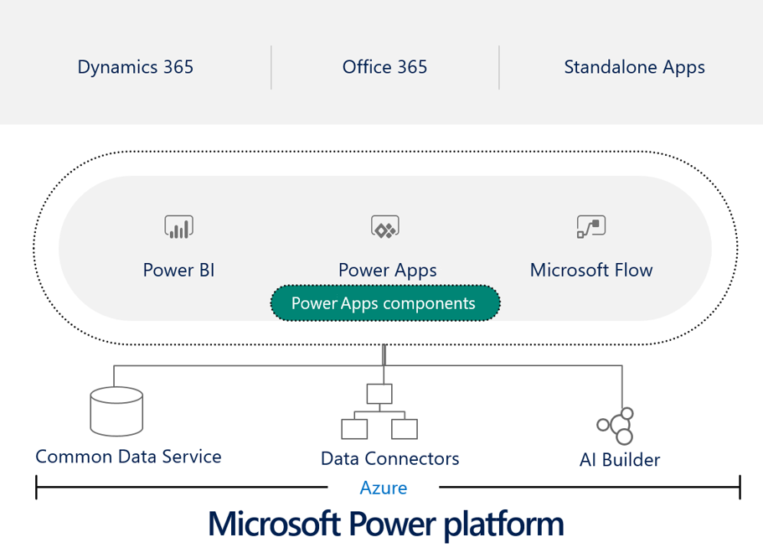
Power Apps component framework architecture
Power Apps Components are built atop of Microsoft's robust Power Platform, which means that you can seamlessly use the wealth of utilities that it provides.
Notes:
Power Apps Components are built atop of Microsoft's robust Power Platform, which means that you can seamlessly use the wealth of utilities that it provides.
When developing a component, you are expected to implement the life cycle methods that are shown in the following table.
These methods are invoked through a Framework Runtime process in a standardized life cycle, as shown in the following illustration.
At the top of the image, the framework calls the init() function for your component. If your component is interactive, you'll also need to handle notification to the Host that the component's output has changed by calling the notifyOutputChanged method. The framework runtime will then call your implemented getOutputs function, which represents all of your component's outputs, and then return that to the runtime. The runtime will then notify the Host of that value, which will perform validation on the output. If the output is found to be valid, it will call the updateView method on your component. If it isn't valid for whatever reason (that is, a business rule found the new output to be invalid), it will call your updateView method and pass the old value along with an error message.
As the following image shows, a Power Apps component is represented as three key areas: a Manifest Input File, its implementation, and any additional resource files that might be needed by the component.
For more information, see What are code components. These concepts are covered in more detail while you're learning how to build your own custom components.

Slide 12
Power Apps component life cycle
When developing a component, you are expected to implement the life cycle methods that are shown in the following table.
Method | Description
init | Required. This method is used to initialize the component instance. Components can kick off remote server calls and other initialization actions in this method. Dataset values cannot be initialized with this method; you will need to use the updateView method for this purpose.
updateView | Required. This method will be called when any value in the component’s property bag has changed.
getOutputs | Optional. Called by the framework prior to the receipt of new data. Use this method when dynamically managing bound properties in a control.
destroy | Required. Invoked when the component is to be removed from the DOM tree. Used for cleanup and to release any memory that the component is using.
Notes:
Power Apps Components are built atop of Microsoft's robust Power Platform, which means that you can seamlessly use the wealth of utilities that it provides.
When developing a component, you are expected to implement the life cycle methods that are shown in the following table.
These methods are invoked through a Framework Runtime process in a standardized life cycle, as shown in the following illustration.

Slide 13
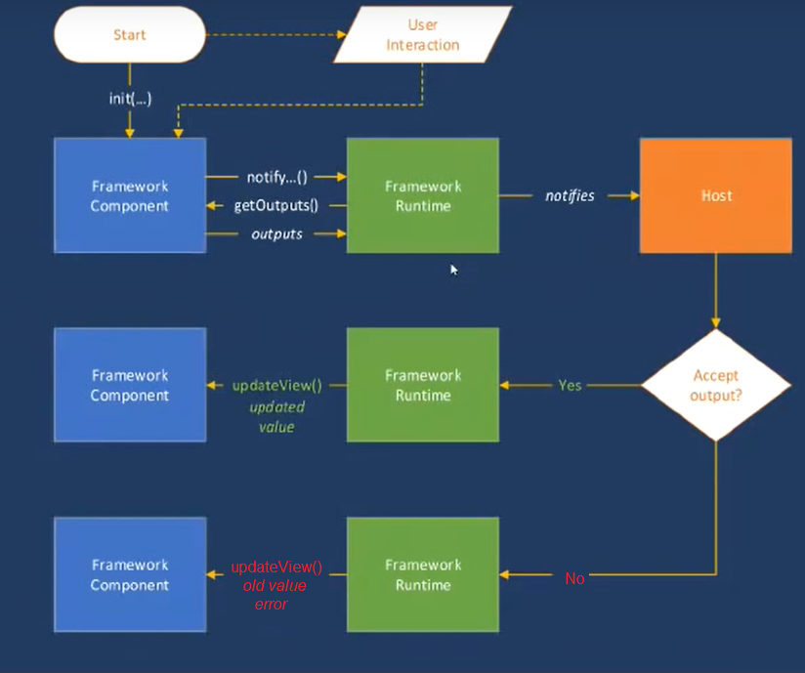
Power Apps component life cycle
These methods are invoked through a Framework Runtime process in a standardized life cycle, as shown in the following illustration.
Notes:
At the top of the image, the framework calls the init() function for your component. If your component is interactive, you'll also need to handle notification to the Host that the component's output has changed by calling the notifyOutputChanged method. The framework runtime will then call your implemented getOutputs function, which represents all of your component's outputs, and then return that to the runtime. The runtime will then notify the Host of that value, which will perform validation on the output. If the output is found to be valid, it will call the updateView method on your component. If it isn't valid for whatever reason (that is, a business rule found the new output to be invalid), it will call your updateView method and pass the old value along with an error message.

Slide 14
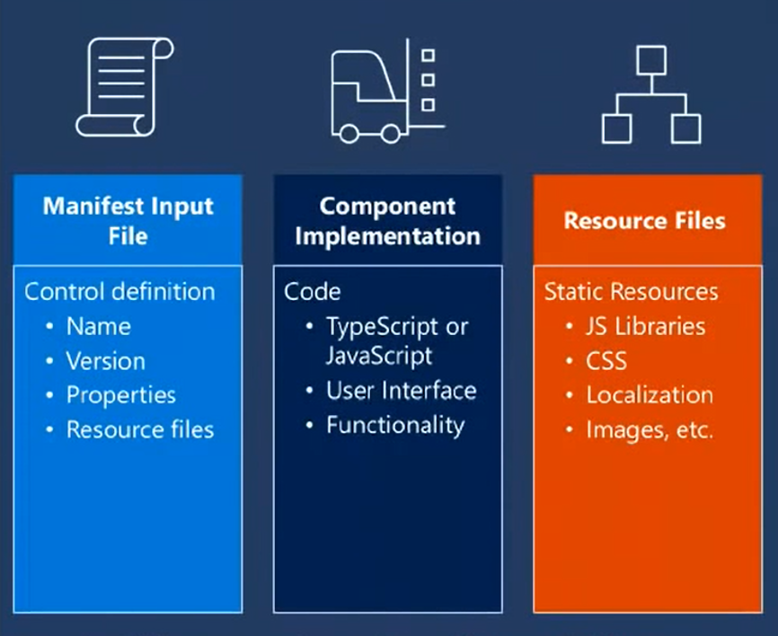
Component makeup
As the following image shows, a Power Apps component is represented as three key areas: a Manifest Input File, its implementation, and any additional resource files that might be needed by the component.
Notes:
For more information, see What are code components . These concepts are covered in more detail while you're learning how to build your own custom components.

Slide 15
Power Apps component tooling
Power Apps CLI
Power Apps component CLI commands
Choose an IDE
Notes:
Microsoft has built a robust CLI framework that exposes scaffolding methods that rapidly expedite your ability to build custom Power Apps components. It provides simple-to-use control templates along with built-in validations to catch issues prior to deployment of your control.
To use the Power Apps CLI, you'll first need to install Npm (comes with Node.js) or Node.js (comes with npm). We recommend that you install LTS (Long Term Support) version 10.15.3 or higher.
For additional prerequisites and a link to the CLI's installation bits, see Install Microsoft Power Apps CLI.
The steps to install CLI are covered in more detail when you learn how to build a Power Apps component.
If you want to see all of the commands that are available through the CLI, see Common commands.
While we recommend that you use Visual Studio or Visual Studio Code to write your components, you can use any IDE of your choice to build custom Power Apps components.

Slide 16
Build a Power Apps component
Notes:
Custom Power Apps components are frequently referred to as code components because they require custom code to implement them. They consist of three elements: a manifest, an implementation, and resources. In the following exercise, you will write your own custom code component: a linear slider control that will look like the following image.

Slide 17
Exercise: Introduction to creating a code component
Follow the exercise in the student manual
Notes:
https://docs.microsoft.com/en-us/learn/modules/build-power-app-component/1-create-code-component

Slide 18
Exercise: Create a code component solution package
Follow the exercise in the student manual
Notes:
https://docs.microsoft.com/en-us/learn/modules/build-power-app-component/2-package-code-component

Slide 19
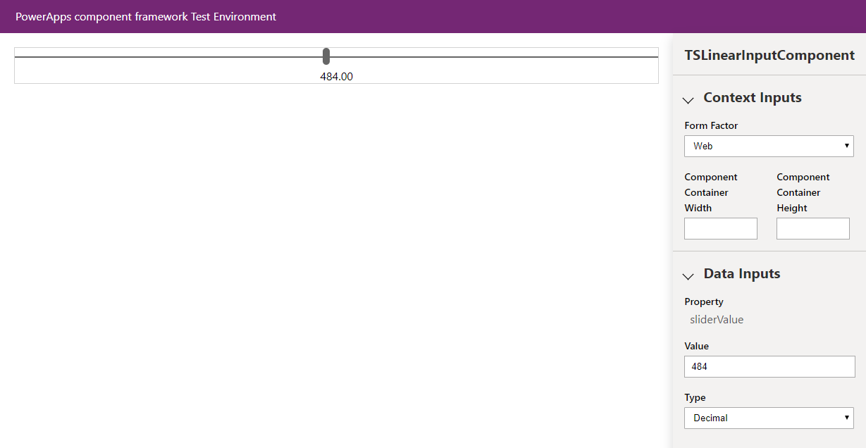
Demo- Test and debug code components
Notes:
https://docs.microsoft.com/en-us/learn/modules/build-power-app-component/3-debug-code-component

Slide 20
Use advanced features with Power Apps component framework
Notes:
This lesson is an add-on for exam coverage purposes

Slide 21
Introduction to using React within a Power Apps component
React is a standardized client framework that is built by Facebook for building user interfaces.
UI fabric
One of the many great developments from Microsoft has been its implementation of UI Fabric, a collection of UX frameworks that you can use to build fluent experiences that fit seamlessly into a broad range of Microsoft products.
Notes:
React is a standardized client framework that is built by Facebook for building user interfaces. It provides a declarative way to create interactive UIs and provides a mechanism to encapsulate components to make complex UIs that manage component states and have high interactivity. Because React is written in JavaScript, you can use this framework within a Power Apps component.
If you're new to React, go to https://reactjs.org/?azure-portal=true, which provides a wealth of tutorials and resources on how to build React components.
One of the many great developments from Microsoft has been its implementation of UI Fabric, a collection of UX frameworks that you can use to build fluent experiences that fit seamlessly into a broad range of Microsoft products. Using UI Fabric within your Power Apps component is as simple as referencing its libraries, and it provides a React-specific version that you can use. For more details on UI Fabric, go to https://developer.microsoft.com/fabric.

Slide 22

Demo - Implement a sample Facepile component
In this example, you'll build a component that uses the Facepile UI Fabric component. The Facepile shows a list of faces or initials in a horizontal lookup, each circle representing a person.
Notes:
Demo and/or Exercise
https://docs.microsoft.com/en-us/learn/modules/component-framework-advanced-topics/1-introduction

Slide 23
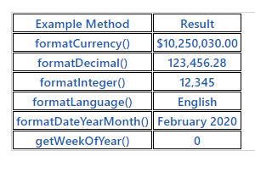
Demo - Use the formatting API in a Power Apps component
Power Apps component framework exposes a formatting API that can be especially useful when you need to format various values in your application.
Notes:
Power Apps component framework exposes a formatting API that can be especially useful when you need to format various values in your application. This unit shows how to use this API by producing an HTML table to illustrate how various methods can be used.
https://docs.microsoft.com/en-us/learn/modules/component-framework-advanced-topics/2-formatting-api

Slide 24
Demo - Use the Microsoft Dataverse web API in a Power Apps component
A common scenario during component development is the requirement to interface with data in your solution's underlying Microsoft Dataverse. The Power Apps component framework exposes a Web API feature to achieve this requirement. This example will illustrate how to perform various CRUD operations by using this feature.
Notes:
https://docs.microsoft.com/en-us/learn/modules/component-framework-advanced-topics/3-web-api

Slide 25
Demo - Write a pop-up Power Apps component
Occasionally, it is required that you display a pop-up window to a user of your application. The Power Apps component framework exposes a pop-up API that allows you to achieve this requirement. The following example will show how to build a pop-up window that displays a loader graphic. In long-running operations, this method can help you achieve a satisfying user experience where the underlying UI is blocked from performing operations.
Notes:
https://docs.microsoft.com/en-us/learn/modules/component-framework-advanced-topics/4-pop-up

